Slide 1
Design Patterns
Chapter 3

Slide 2
OO Design Redux
Consider a GUI type named Window
Unadorned, but functional
Now suppose we want some more full-featured windows
Bordered, scrollable, etc.
How do we design this?

Slide 3
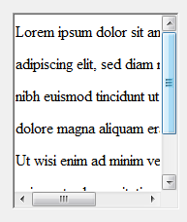
OO Design 101
A BorderedWindow is most assuredly a Window
Sounds like an “is-a” to me!
Ditto ScrollableWindow
Sort of obvious, no?

Slide 4
Our Simple Hierarchy

Slide 5
Counting Classes
Note that the number of classes is quite predictable:
1 (= C(2,0)) for the root
2 (= C(2,1)) for the single-featured subclasses
2 features total, choosing 1 at a time
1 (=C(2,2)) for the leaf
Combines all features
Total of 4

Slide 6
Evaluating Our Design
Ignore details of multiple inheritance
We can always work around that
Any other problems?

Slide 7
Problem #1
The subclasses have operations that the Window superclass doesn’t
scroll, for example
Not completely an “is-a”
But it isn’t unusual for a subclass to add operations; no biggie
We could put these methods in Window
But they’d be no-ops in the subclasses that don’t use them
Someone isn’t encapsulating variation!

Slide 8
Problem #2
What if we need to add another important, independent windowing feature?
WhizbangWindow
What impact does this have on the hierarchy?

Slide 9
Hierarchical “Progress”

Slide 10
Definitely Counting Classes
1 (= C(3,0)) for the root
3 (= C(3,1)) for the first row
Single-featured
3 (= C(3,2)) for the second “row”
Double-featured
1 (= C(3,3)) for the leaf
All three
Total of 8

Slide 11
Looking Ahead
C(n,0) + C(n,1) + … + C(n, n-1) + C(n, n)
Equals 2^{n}
Can anyone say “combinatorial explosion”?

Slide 12
An Alternative?
Maybe it would be better to avoid the inheritance web, and have a single level (broad) hierarchy
It gets rid of MI!
What do we lose?
How many classes are needed?
The same number! No fewer!

Slide 13

Starbuzz Coffee
Has 4 concrete specializations of the Beverage type
HouseBlend, DarkRoast, Decaf, Espresso
Also, there are four “features” that can adorn these drinks
SteamedMilk, Soy, Mocha, WhippedMilk
( see page 81)

Slide 14
Principles???
Which of the design principles does this design violate?
What happens if the price of milk goes up?
What do they do when they add a new caramel topping?
Separate what varies from what stays the same!
Favor Composition over Inheritance!
Maybe more!

Slide 15
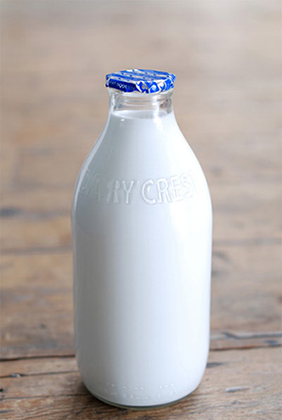

Another Attempt
These “features” (condiments) really feel like attributes, don’t they?
So let’s just move them to Beverage
The concrete classes can compute the correct cost
See next slide
Image sources:
www.stanpacnet.com, healthcareaboveall.com

Slide 16
A Better Hierarchy?

Slide 17

Take #2, Calculating Cost
Write the code on page 83

Slide 18
Evaluating Take #2
Beverage.cost( ) must check for the presence of each condiment
As new condiments arrive, Beverage’s code must change noticeably
New fields and methods, additional processing
We would rather be able to add new condiments without changing Beverage at all!
“Separate what varies”
At runtime! (Trivial in Smalltalk, Python, or Ruby)

Slide 19

Evaluating Take #2 continued
A new beverage may arrive that does not accommodate all condiments
Who ever heard of mocha tea?
So we once again find ourselves removing functionality in a derived class
Violates “is-a”
Can result in repeated code
As many no-ops will pop up

Slide 20
Designing for Change
What requirements or other factors might change that will impact this design?
(P. 84)

Slide 21

Inheritance -- Review
P. 85

Slide 22

The Open-Closed Principle
Classes should be open for extension but closed for modification
Say what?
It is better to extend a class by not changing its code
Clients dependent on it will have to change
New bugs can emerge
We have seen how inheritance often violates this principle
But there are other ways to extend classes!
Composing a wrapper, for instance

Slide 23
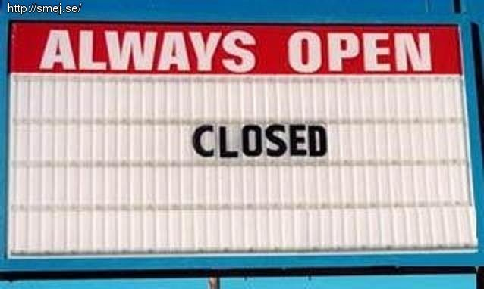
Both Open and Closed???
P. 87

Slide 24
The Decorator Pattern Structural
Intent:
Add additional responsibilities to an object dynamically.
Context:
Applies when clients program to an abstraction (not its subtypes). A decorator can be used in the same way as its subject (“is-a”). The set of additional responsibilities can be open-ended. Existing subject code does not change. Multiple decorators can be combined sequentially.
Solution:
The Decorator implements the same interface as the abstraction. It manages a concrete instance of the abstraction via composition, and adds additional functionality. It calls the managed object’s methods and combines the result with the additional functionality.

Slide 25
The Decorator Pattern: From POSA, V4 (Pattern-Oriented Software Architecture)
Problem
It is sometimes necessary to extend the methods of an object dynamically with additional pre-and post-processing behavior, such as data compression, logging, or security checks. Such extensions, however, should not affect other instances of the same class if they do not need these extensions.
Therefore:
Wrap the original object in a decorator object whose interface conforms to the original object. Implement the optional, extra functionality within the decorator object, and forward requests on its interface to the original object after or before its add-on functionality is executed

Slide 26
Class Sketch
⬅ Usually optional

Slide 27
Object Sketch

Slide 28
Decorators and Starbuzz
Suppose you want a DarkRoast Mocha Whip
The base component object is DarkRoast
You can wrap it in a Mocha decorator
Or do Whip first, shouldn’t matter
Then wrap it in a Whip decorator
Whip.cost( ) calls Mocha.cost( ) which calls DarkRoast.cost( )
The total cost is accumulated and returned
The composite object can be used anywhere a Beverage can! (p. 88-89)

Slide 29
Decorators and StarBuzz Object Sketch View

Slide 30
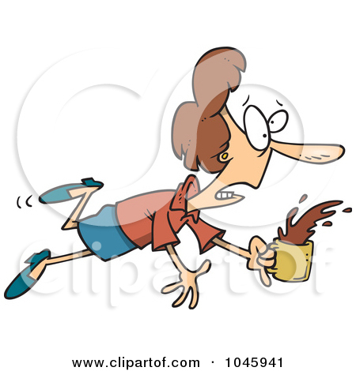
Dynamic Coffee!
Writing the code: P. 95-98

Slide 31
No Dumb Questions
Page 99
Q1: Does a Decorator have to implement ALL the methods of a base class, even if it only cares about decorating one of them?
Q2: Does the order of decoration matter?
Q3: What does this mean for adding Mocha to tea?
You can’t forbid it easily
If someone wants mocha in their tea, you have to let them do it – or change your design
Or you could have CoffeeDecorators, TeaDecorators, and SoupDecorators
Not so bad as long as there isn’t a great deal of overlap…
Q4: What if the condiments cost differently depending on the type of beverage?
The decorator could query the type of the object it surrounds
Or you could have different types of Decorators
Either way, it’s not ideal (you aren’t quite programming to the interface)

Slide 32
Inheritance vs. Composition
“Favor Composition over Inheritance”
Which does the Decorator use?
How does it support this principle?
P. 93

Slide 33
Condiments, Revisited
Couldn’t the coffee object simply have a list of Condiments?
That’s composition, right?
In this case, yes.
Other cases would not work well with a list of attributes
See Program 3.
But then the coffee object needs to know about its condiments:
In calculating cost
AND in displaying its Description

Slide 34
(Show plain example)

Slide 35
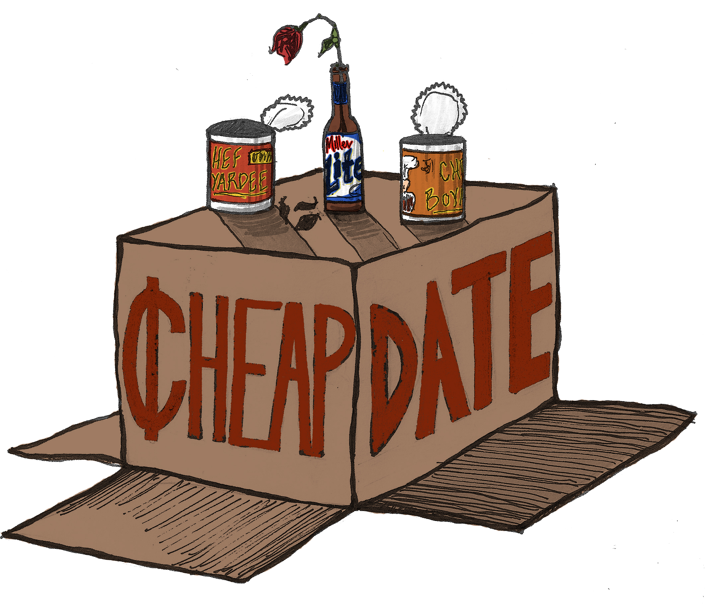
Coffee on the Cheap
You found a Starbuzz discount coupon online!
How do we support it?
A simple discount decorator!
(files: Discount1)
Later:
Is it possible to apply it to just part of the drink?

Slide 36
Discount Questions
We checked that a discount had been applied outside the decorated object. What if the context had changed (and we had to ask the decorated object itself?)
What if we wanted to remove the Discount decorator?
Lessons:
Visibility into the type of decorations breaks encapsulation
Undoing decorations is ugly

Slide 37

Different Sizes
P. 99
Supersize me!!!
What’s wrong with the solution presented in the book? (p. 99, 107)
Notes:
Size should not be a settable attribute. (See text on p. 99 and at top of page 107.)
It shows the inherent problems with getters and setters

Slide 38
Variation #3
Suppose you want to find out what type of beverage you have, regardless of its condiments?
I want to know if I have a Dark Roast or a Decaf…
Let’s try to implement that…
(files: basetype)
Note: btype() method in the BeverageDecorator class

Slide 39
Variation #4
The description now prints:
Dark Roast, Sugar, Milk
But if there are no condiments, how do I print:
Dark Roast, Black
Let’s try it…
IsBlack: What’s wrong with this solution?
IsBlack2: maybe better. Why?
Notes:
IsBlack: bad design because it means the base object has to know about decoration. Violates all sorts of principles (mainly the Dependency Inversion Principle in some way, also Open-Closed Principle)
IsBlack2: better, but has problems too.

Slide 40

Variation #5
Our special this week is Dark Roast, so we give a 5% discount for condiments on a Dark Roast.
How do we do that?
(Discount2)
Design issue?
(what principle does it violate?)
Notes:
We just added a method to the base class for the purpose of giving information to the decorators!
Wow, this violates the Open-Closed principle!

Slide 41
More Variations
A decorator can add new methods
Not the usual case
Usually, it embellishes existing functionality
But this is the case with Java’s I/O

Slide 42
Java’s I/O Layout
Several decorators add functionality to the stream and reader/writer classes
Example:
readLine( ) is not in the superclasses
It is added by BufferedInputStream and BufferedReader
See next slide

Slide 43
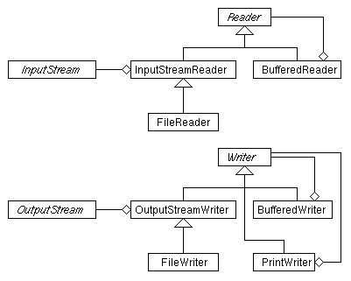
Java I/O

Slide 44

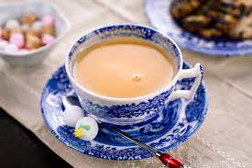
What about Tea?
What condiments do you add?
Sugar, milk, lemon, espresso … ?
What problems are there?

Slide 45
Looking back at the principles
What about:
Favor Composition over Inheritance?
We tried a list of condiments and it didn’t work …
Or maybe it would – but how?
(Hint: think also about separate what varies from what stays the same!)

Slide 46
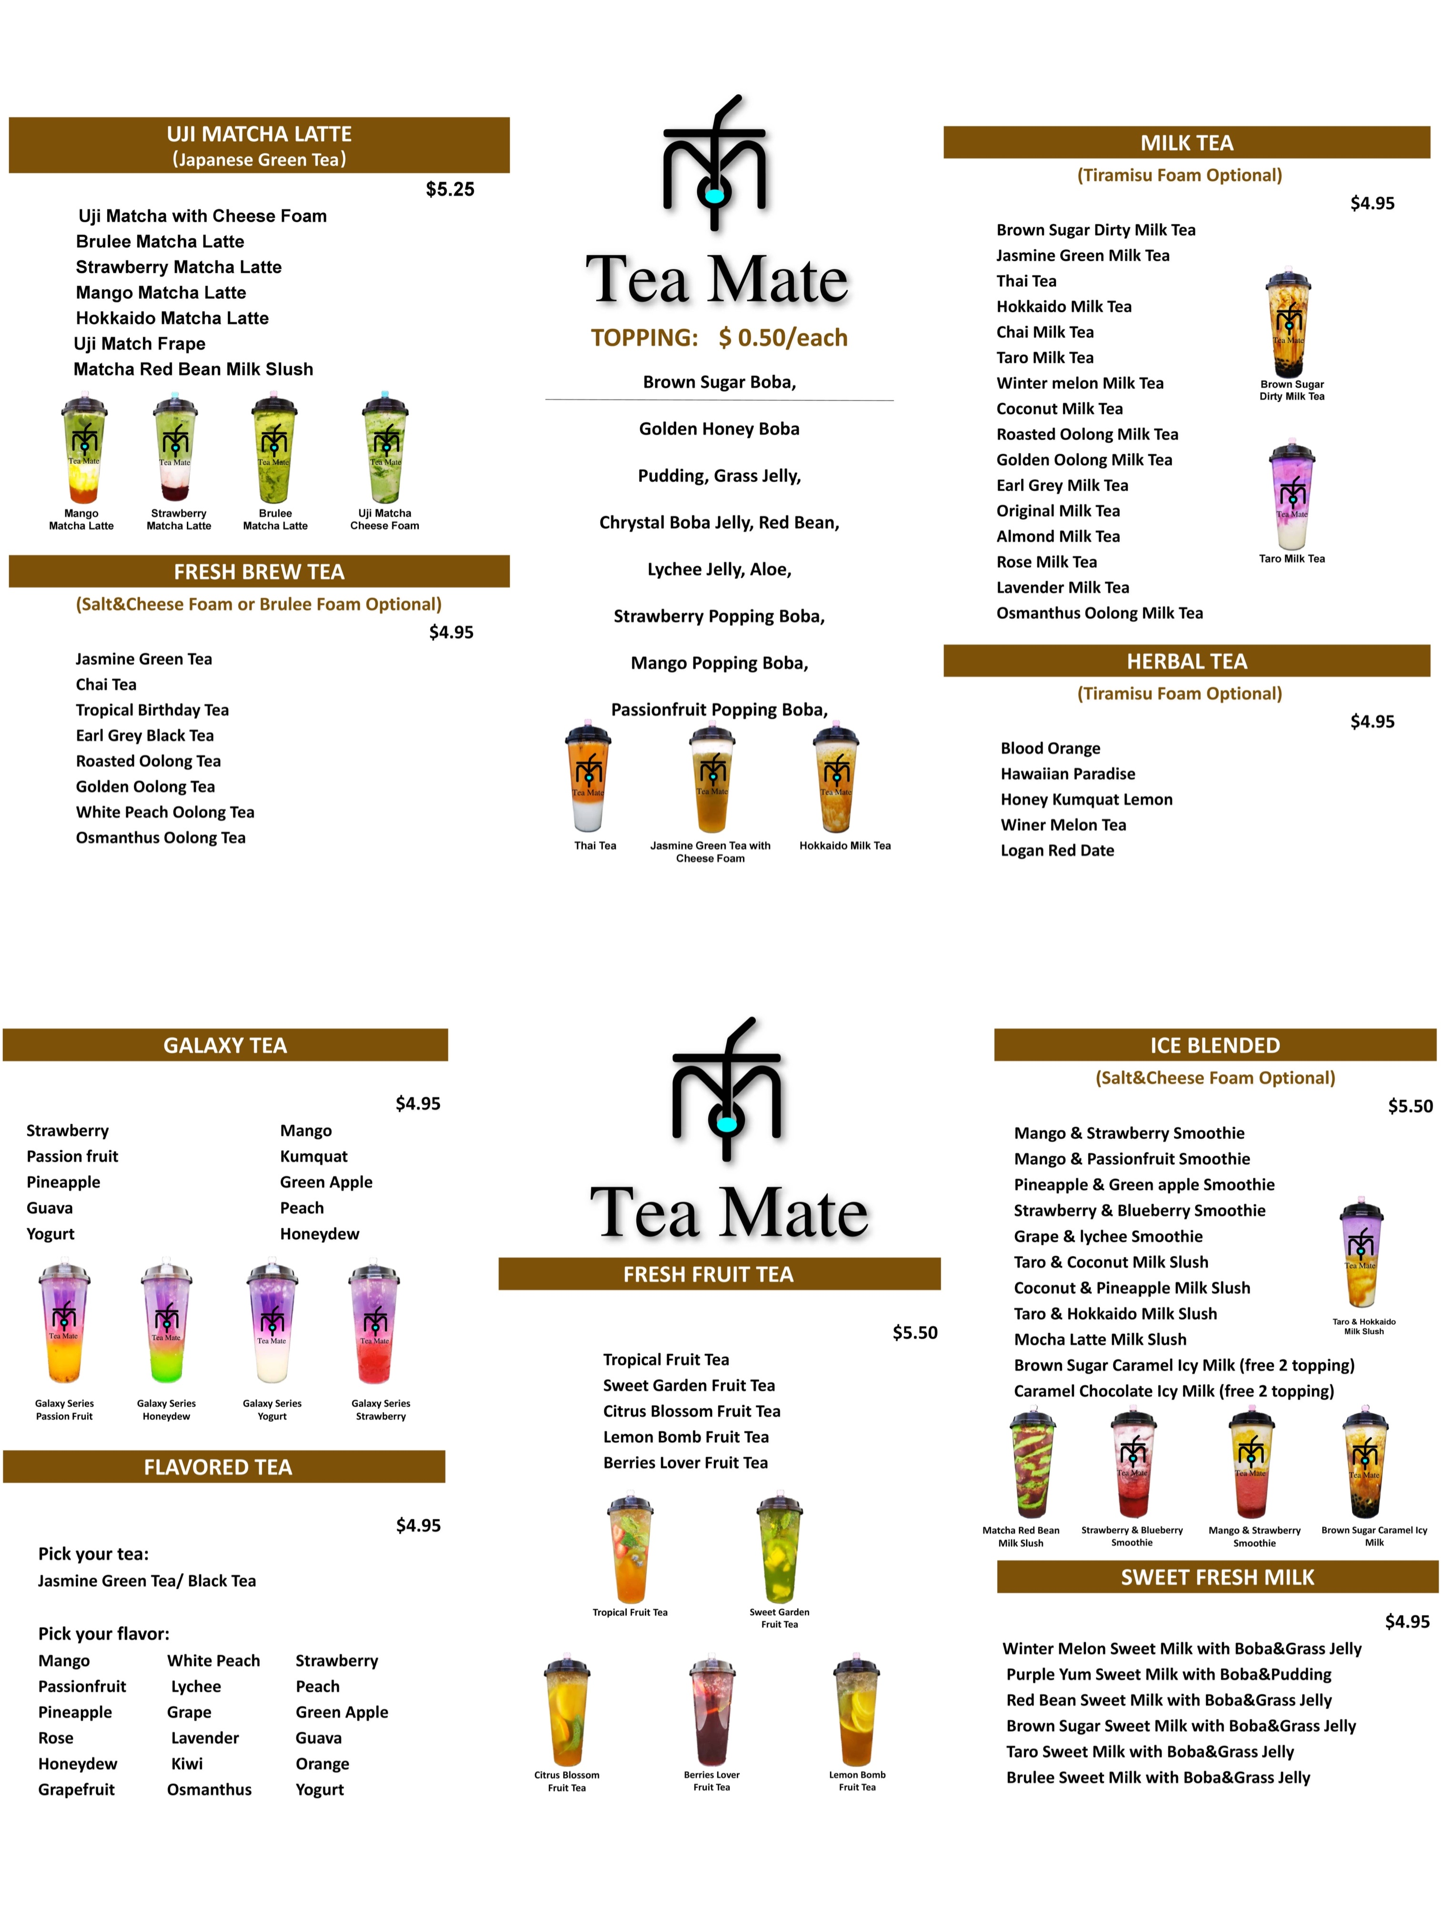
Another try …
Make the condiments a hierarchy unto itself
How to implement:
“is Black”?
Discounts?
Sizes?
Displaying condiments differently?

Slide 47
That troublesome tea!
It still doesn’t handle the tea problem (yet)
How to prevent adding mocha to tea or lemon to coffee?
But we have some options. What can you come up with?
So what about adding soup to the menu?
(does it even fit? If so, how?)
Notes:
Options:
Check in the main program (not great, hard to extend cleanly)
Check types in the Coffee/Tee add_condiment() method (type checking isn’t good, not cleanly extensible, and violates DIP)
Have a list of acceptable condiments in each beverage type (cleanest and easiest to extend)
Soup: can fit in, especially with option 3.

Slide 48
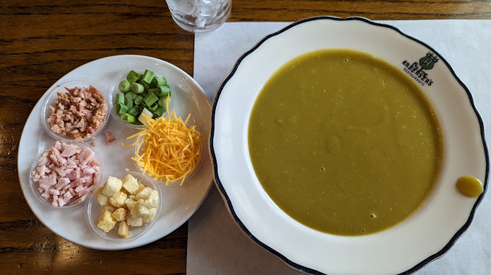
Soup condiments

Slide 49

Which is the better approach?
In this case (no tea):
Decorator or condiment list hierarchy?
In general:
What do you consider to decide?

Slide 50
Principles Review
Open-Closed Principle

Slide 51
Program 3!!!!

